Slide 1
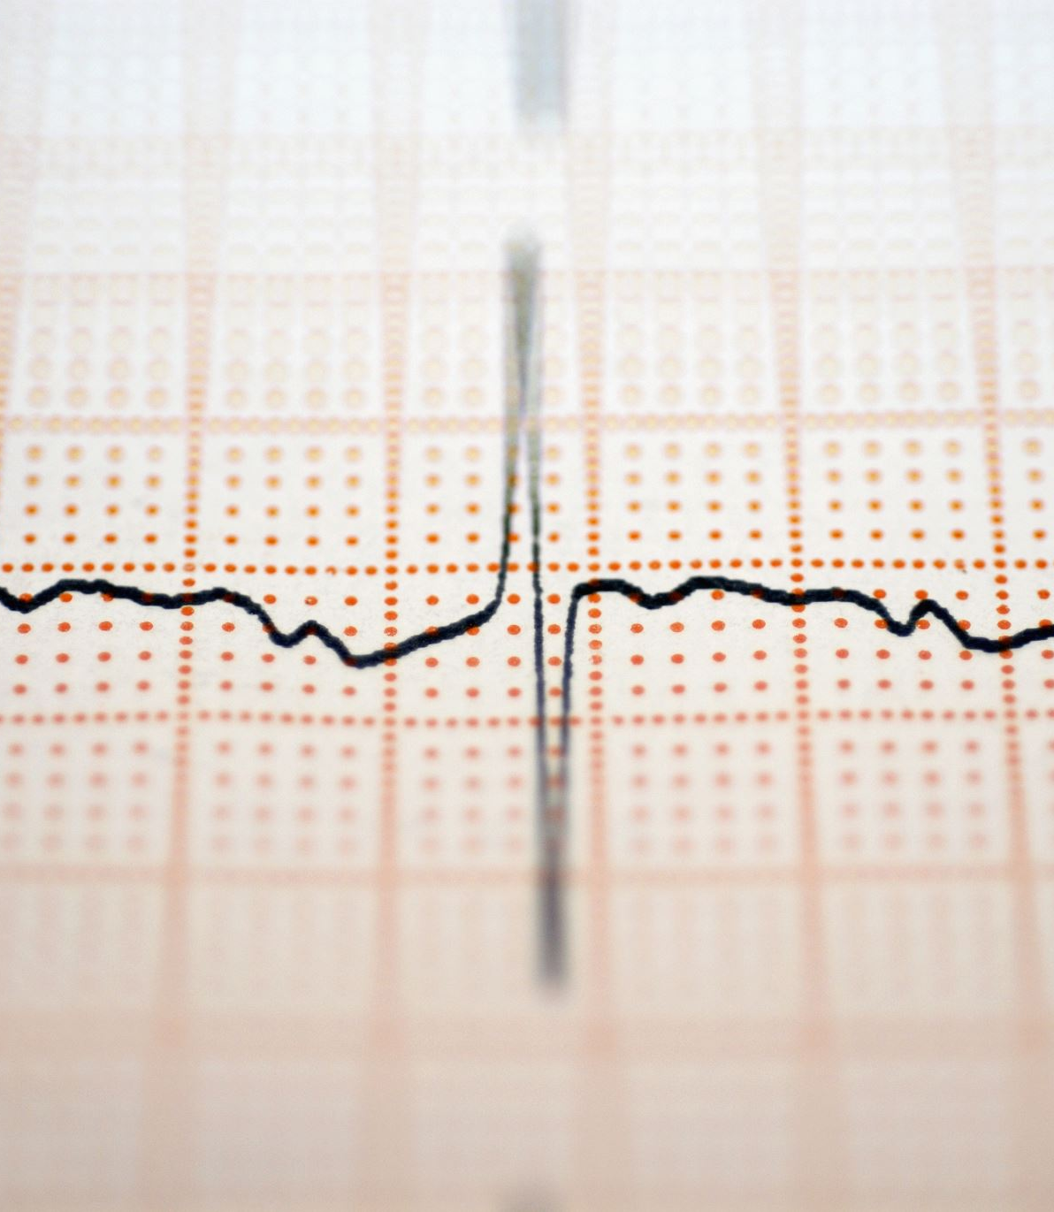
VITAL SIGNS UNRAVELING PATTERNS OF HEART HEALTH FROM CLINICAL DATA INSIGHTS
By Yiran Hu and Koki James

Slide 2

Introduction to Heart Disease in the U.S.
The Leading Cause of Death
Prevalence: Heart disease has been the leading cause of death in the U.S. for over 100 years.
Statistics: Over 700,000 deaths in 2022, more than strokes, cancer, and respiratory diseases combined.
Lifestyle Impacts: Key factors include physical inactivity, obesity, and substance abuse.
Importance of Early Detection
Progression and Management: Heart disease develops over time. Identifying high risks early can lead to significant health improvements.
Reversibility: While heart disease is typically not reversible, early detection allows for management of symptoms and better outcomes.
Study Objective
Data Analysis: Utilizing a dataset from a Cleveland hospital to analyze trends and insights from patients presenting with chest discomfort.

Slide 3

Dataset Description and Selection Justification
Dataset Overview
Sourced from Kaggle, a leading platform for data science and machine learning.
Dataset: Heart Attack Analysis & Prediction Dataset
Reasons for Choosing This Dataset
1. Comprehensiveness and Diversity
2. Well-Organized and Clean Data
3. Reliability and Predictive Insights

Slide 4
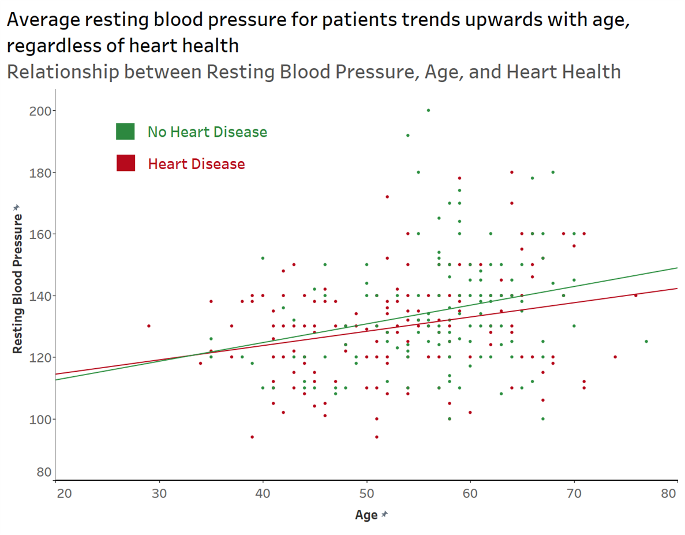
The Correlation of Resting Blood Pressure and Age with Heart Disease
Findings
High resting blood pressure observed in patients with chest pain
The younger age demographic tended to have more people with heart disease that had high blood pressure.
Limitations
Data limited to patients presenting chest discomfort at the Cleveland hospital.
High blood pressure is a concern for all, indicating an overall high risk for heart disease.
Limited data for individuals below 40 and above 70 years.

Slide 5
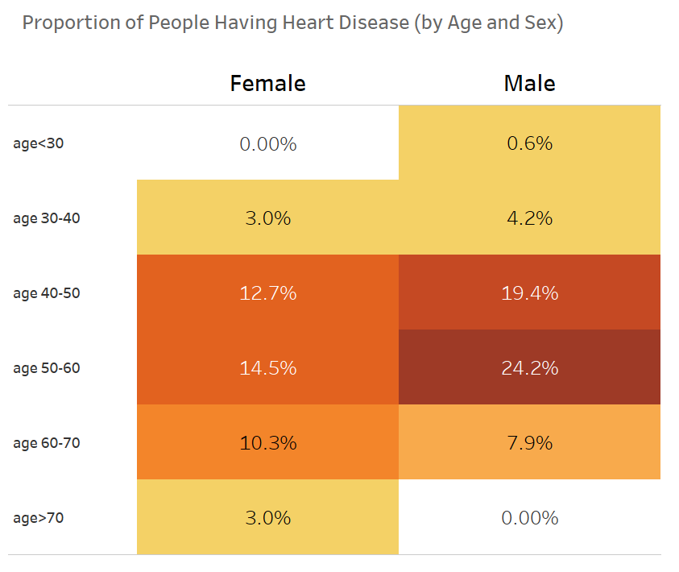
The Distribution of Heart Disease Across Different Age Groups and Gender
Findings
Males aged 50-60 show the highest proportion of heart disease at 24.2%.
Increased risk of heart disease seems correlated with males aged 40-60 and females aged 50-60.
Limitations
Disparity in the number of individuals per age/gender group may skew results.
Low proportion of heart disease in individuals over 70 and below 30 in the dataset should not be misinterpreted as low risk due to small sample size.

Slide 6
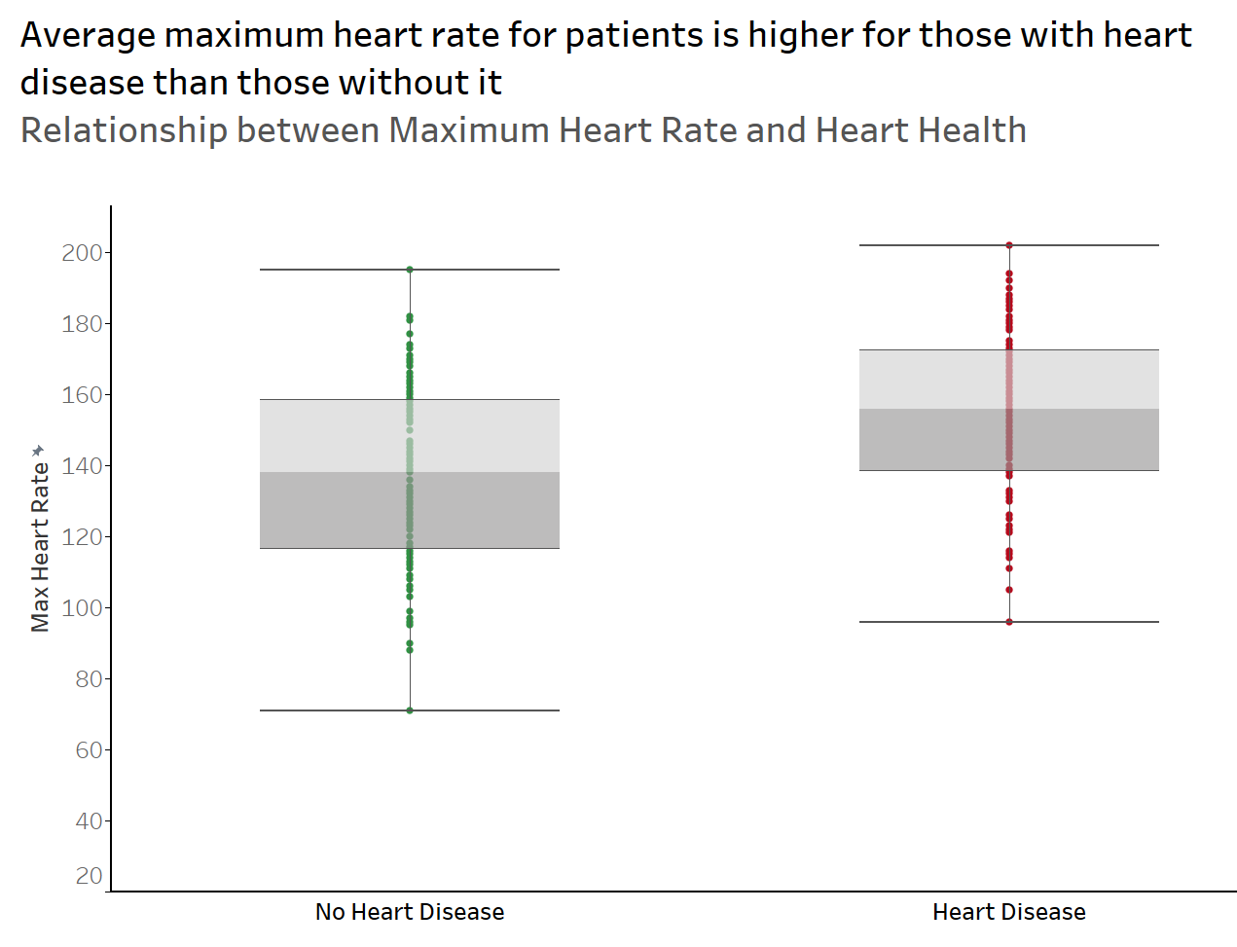
The Distribution of Maximum Heart Rate Relative to Heart Disease
Findings
Individuals with heart disease have higher average maximum heart rates compared to those without.
Higher heart rates may suggest that the heart is working harder in individuals with heart disease, indicating a possible positive correlation with heart disease.
Limitations
Results are representative of the study dataset and not the general population.
The procedure for calculating maximum heart rate is not specified—results might vary if taken during or after exercise.

Slide 7
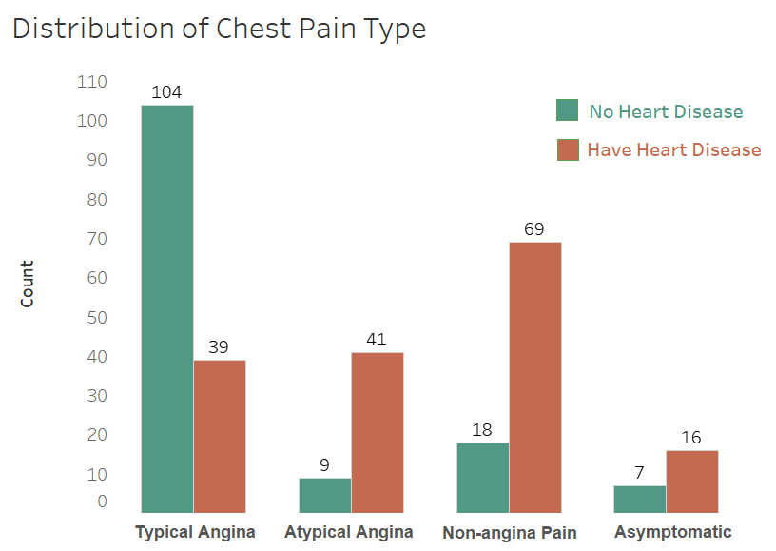
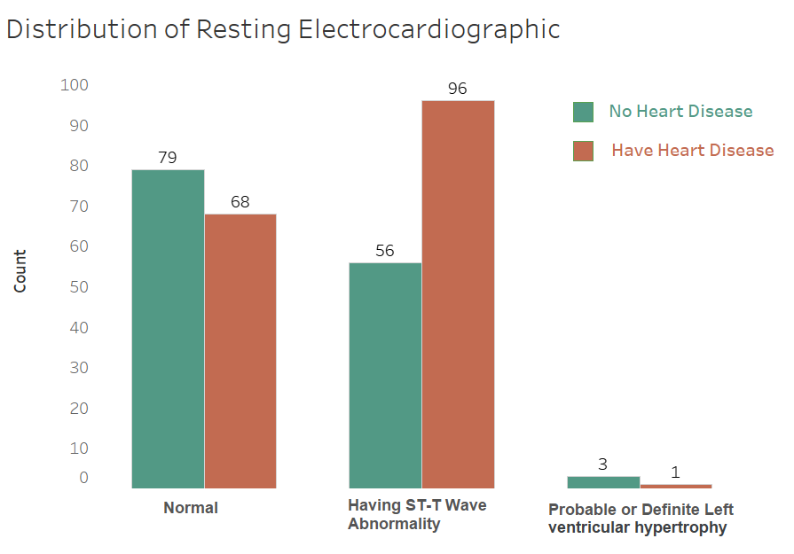
The Distribution of Chest Pain and Electrocardiographic Results in Relation to Heart Disease

Slide 8
Conclusion and Call to Action
Overview of Findings
Correlation noted between high blood pressure and chest pain.
Atypical angina and ST-T Wave abnormalities prevalent in heart disease patients.
Increased heart rate associated with higher heart disease risk.
Community Implications
Awareness for early detection, particularly in 40-60 age group.
Being more conscious of health at younger ages
Technology like smartwatches can aid in regular health monitoring.
Research and Data Transparency
Encourages exploration of under-researched areas, such as gender differences in heart disease presentation.
Urges hospitals to publish data to fuel further analysis and model creation.

Slide 9
References
https://newsroom.heart.org/news/more-than-half-of-u-s-adults-dont-know-heart-disease-is-leading-cause-of-death-despite-100-year-reign#:~:text=%E2%80%9CHeart%20disease%20has%20now%20been,Wu%2C%20M.D.%2C%20Ph.
https://injuryfacts.nsc.org/all-injuries/deaths-by-demographics/all-leading-causes-of-death/#:~:text=The%20top%20three%20leading%20causes,Preventable%20Injury
https://www.cdc.gov/heartdisease/about.htm
https://samhealth.org/news/can-you-reverse-heart-disease/#:~:text=Is%20it%20reversible%3F,Wood.
https://www.kaggle.com/datasets/rashikrahmanpritom/heart-attack-analysis-prediction-dataset?resource=download
https://www.heart.org/en/health-topics/high-blood-pressure/understanding-blood-pressure-readings
https://www.mayoclinic.org/diseases-conditions/high-blood-pressure/in-depth/high-blood-pressure/art-20045868#:~:text=High%20blood%20pressure%20forces%20the,heart%20attack%20and%20heart%20failure

